Slide 1
Data Structures
6. Complexity Analysis

Slide 2
Comparing Algorithms
Given two or more algorithms to solve the same problem, how do we select the best one?
Some criteria for selecting an algorithm
Is it easy to implement, understand, modify?
How long does it take to run it to completion?
How much of computer memory does it use?
Software engineering is primarily concerned with the first criteria
In this course we are interested in the second and third criteria

Slide 3
Comparing Algorithms
Time complexity
The amount of time that an algorithm needs to run to completion
Better algorithm is the one which runs faster
Has smaller time complexity
Space complexity
The amount of memory an algorithm needs to run
In this lecture, we will focus on analysis of time complexity

Slide 4
How To Calculate Running Time
Most algorithms transform input objects into output objects
The running time of an algorithm typically grows with input size
Idea: analyze running time as a function of input size
sorting
algorithm
5
3
1
2
1
2
3
5
input object
output object

Slide 5
How To Calculate Running Time
Most important factor affecting running time is usually the size of the input
Regardless of the size n of an array the cost will always be same
Every element in the array is checked one time
int find_max( int *array, int n ) {
int max = array[0];
for ( int i = 1; i < n; ++i ) {
if ( array[i] > max ) {
max = array[i];
}
}
return max;
}

Slide 6
How To Calculate Running Time
Even on inputs of the same size, running time can be very different
Idea: Analyze running time for different cases
Best case
Worst case
Average case
int search(int arr[], int n, int x) {
int i;
for (i = 0; i < n; i++)
if (arr[i] == x)
return i;
return -1;
}

Slide 7
How To Calculate Running Time
Best case running time is usually not very useful
Average case time is very useful but often hard to determine
Worst case running time is easier to analyze
Crucial for real-time applications such as games, finance and robotics

Slide 8
Experimental Evaluations of Running Times
Write a program implementing the algorithm
Run the program with inputs of varying size
Use clock methods to get an accurate measure of the actual running time
Plot the results

Slide 9
Limitations Of Experiments
Experimental evaluation of running time is very useful but
It is necessary to implement the algorithm, which may be difficult
Results may not be indicative of the running time on other inputs not included in the experiment
In order to compare two algorithms, the same hardware and software environments must be used

Slide 10
Theoretical Analysis of Running Time
Uses a pseudo-code description of the algorithm instead of an implementation
Characterizes running time as a function of the input size n
Takes into account all possible inputs
Allows us to evaluate the speed of an algorithm independent of the hardware/software environment

Slide 11
Analyzing an Algorithm – Operations
Each machine instruction is executed in a fixed number of cycles
We may assume each operation requires a fixed number of cycles
Idea: Use abstract machine that uses steps of time instead of secs
Each elementary operation takes 1 steps
Example of operations
Retrieving/storing variables from memory
Variable assignment =
Integer operations + - * / % ++ --
Logical operations && || !
Bitwise operations & | ^ ~
Relational operations == != < <= => >
Memory allocation and deallocation new delete

Slide 12
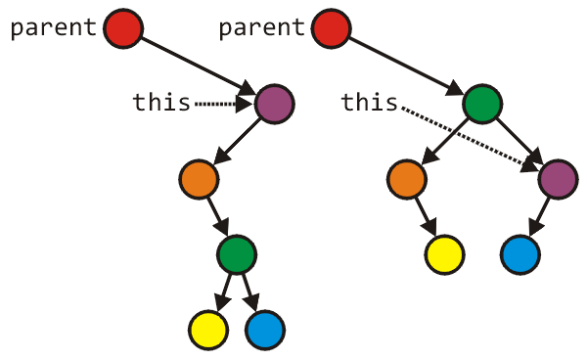
Analyzing an Algorithm – Blocks of Operations
Each operation runs in a step of 1 time unit
Therefore, any fixed number of operations also run in 1 time step
s1; s2; …. ; sk
As long as the number of operations k is constant
Tree_node *lrl = left->right->left;
Tree_node *lrr = left->right->right;
parent = left->right;
parent->left = left;
parent->right = this;
left->right = lrl;
left = lrr;
// Swap variables a and b
int tmp = a;
a = b;
b = tmp;

Slide 13
Analyzing an Algorithm
// Input: int A[N], array of N integers
// Output: Sum of all numbers in array A
int SumArray(int A[], int n){
int s=0;
for (int i=0; i< n; i++)
s = s + A[i];
return s;
}
1
2
3
4
5
6
7
8
Operations 1, 2, and 8 are executed once
Operations 4, 5, 6, and 7: Once per each iteration of for loop n iteration
Operation 3 is executed n+1 times
The complexity function of the algorithm is : T(n) = 5n +4

Slide 14
Analyzing an Algorithm – Growth Rate
Estimated running time for different values of n:
n = 10 => 54 steps
n = 100 => 504 steps
n = 1,000 => 5004 steps
n = 1,000,000 => 5,000,004 steps
As n grows, number of steps T(n) grow in linear proportion to n

Slide 15
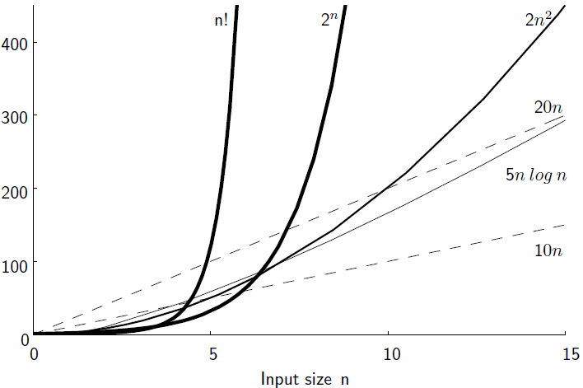
Growth Rate

Slide 16
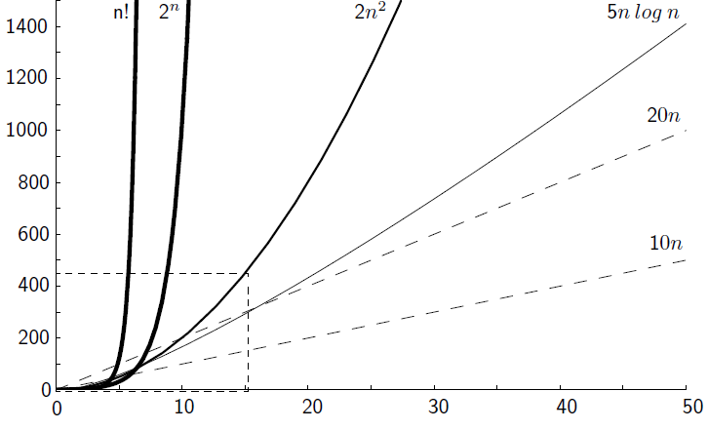
Growth Rate

Slide 17
Growth Rate
Changing the hardware/software environment
Affects T(n) by a constant factor, but
Does not alter the growth rate of T(n)
Thus, we focus on the big-picture which is the growth rate of an algorithm
The linear growth rate of the running time T(n) is an intrinsic property of algorithm sumArray

Slide 18
Constant Factors
The growth rate is not affected by
Constant factors or
Lower-order terms
Examples
10²n + 10⁵ is a linear function
10⁵n² + 10⁸n is a quadratic function

Slide 19
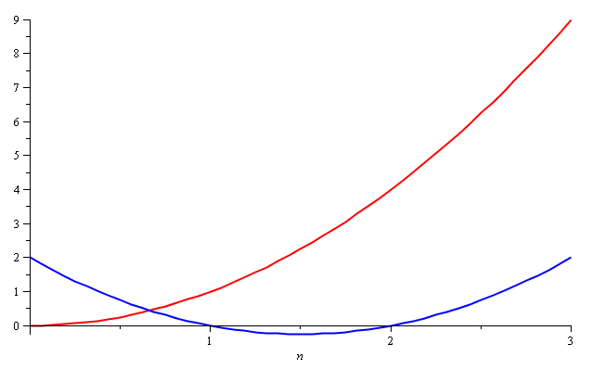
Growth Rate – Example
Consider the two functions
f(n) = n²
g(n) = n² – 3n + 2
Around n = 0, they look very different

Slide 20
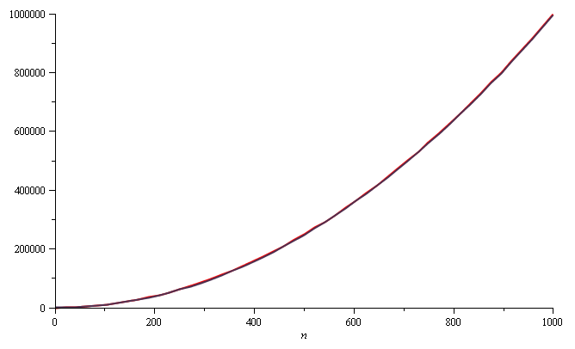
Growth Rate – Example
Yet on the range n = [0, 1000], f(n) and g(n) are (relatively) indistinguishable

Slide 21
Growth Rate – Example
The absolute difference is large, for example,
f(1000) = 1 000 000
g(1000) = 997 002
But the relative difference is very small
The difference goes to zero as n → ∞

Slide 22
Constant Factors
The growth rate is not affected by
Constant factors or
Lower-order terms
Examples
10²n + 10⁵ is a linear function
10⁵n² + 10⁸n is a quadratic function
How do we get rid of the constant factors to focus on the essential part of the running time?
Asymptotic Analysis

Slide 23
Upper Bound – Big-Oh Notation
Indicates the upper or highest growth rate that the algorithm can have
Ignore constant factors and lower order terms
Focus on main components of a function which affect its growth
Definition: Given functions f(n) and g(n)
We say that f(n) is O(g(n))
If there are positive constants c and n₀ such that
f(n) ≤ cg(n) for n ≥ n₀

Slide 24
Big-Oh Notation – Examples
7n-2 is O(n)
Need c > 0 and n₀ ≥ 1 such that 7n-2 ≤ c.n for n ≥ n₀
True for c = 7 and n₀ = 1
3n³ + 20n² + 5 is O(n³)
Need c > 0 & n₀ ≥ 1 such that 3n³ + 20n² + 5 ≤ c.n³ for n ≥ n₀
True for c = 4 and n₀ = 21
3 log n + 5 is O(log n)
Need c > 0 & n₀ ≥ 1 such that 3 log n + 5 ≤ clog n for n ≥ n₀
True for c = 8 and n₀ = 2

Slide 25
Analyzing an Algorithm
Simple Assignment
a = b
O(1)
Simple loops
for(i=0; i<n; i++) { s; }
O(n)
Nested loops
for(i=0; i<n; i++)
for(j=0; j<n; j++) { s; }
O(n²)

Slide 26
Analyzing an Algorithm
Loop index doesn’t vary linearly
h = 1; while ( h <= n ) { s; h = 2 * h;
}
h takes values 1, 2, 4, … until it exceeds n
There are 1 + log₂n iterations
O(log₂ n)

Slide 27
Analyzing an Algorithm
Loop index depends on outer loop index
for(j=0;j<=n;j++)
for(k=0;k<j;k++){ s; }
Inner loop executed 0, 1, 2, 3, …., n times
O(n²)
n
n(n+1)
Σ i =
i=1
2

Slide 28
Relatives of Big-Oh
Big-Omega
f(n) is Ω(g(n))
If there is a constant c > 0 and an integer constant n₀ ≥ 1
Such that f(n) ≥ c.g(n) for n ≥ n₀
Big-Theta
f(n) is Θ(g(n))
if there are constants c₁ > 0 and c₂ > 0 and an integer constant n₀ ≥ 1
such that c₁.g(n) ≤ f(n) ≤ c₂.g(n) for n ≥ n₀

Slide 29
Intuition for Asymptotic Notation
Big-Oh
f(n) is O(g(n)) if f(n) is asymptotically less than or equal to g(n)
Big-Omega
f(n) is Ω(g(n)) if f(n) is asymptotically greater than or equal to g(n)
Note: f(n) is Ω(g(n)) if and only if g(n) is O(f(n))
Big-Theta
f(n) is Θ(g(n)) if f(n) is asymptotically equal to g(n)
Note: f(n) is Θ(g(n)) if and only if
g(n) is O(f(n)) and
f(n) is O(g(n))

Slide 30
Final Notes
Even though in this course we focus on the asymptotic growth using big-Oh notation, practitioners do care about constant factors occasionally
Suppose we have 2 algorithms
Algorithm A has running time 30000n
Algorithm B has running time 3n2
Asymptotically, algorithm A is better than algorithm B
However, if the problem size you deal with is always less than 10000, then the quadratic one is faster
Running time
A
B
10000
problem size

Slide 31
Any Question So Far?

